Slide 1
Lecture 7 – Describing System Architecture and Trade Studies

Slide 2
Overview
What is systems architecture ?
Elements of systems architecture
DOD Architecture Framework (DODAF)
Architecture Description Documents
Trade Studies
  Semi-Numerical Type Analysis
Notes:
The Department of Defense has done the most to attempt to define architecture and as a major part of the economy drives a lot of architecture work in industry because most companies that do joint DOD and commercial work don’t like to change processes depending on the customer.
We’ll talk generically about architecture and in some more detail about the DOD AF

Slide 3
What is system architecture ?
Originally used in buildings to describe the arrangement of components and their relation to each other and the external environment
Appropriated by computer scientists for use in describing different types of information system organization
Now generally used in systems engineering of all types

Slide 4
Definition
The fundamental organization of a system, embodied in its components, their relationships to each other and the environment, and the principles governing its design and evolution. From ANSI/IEEE 1471-2000.
The architecture may be
  Functional – how does it work ?
  Operational – how does the operator see it ?
  Technical – what standards, interfaces and fundamental operations exist ?
  Physical – what hardware is there and where is it located ?
The system architecture is the fundamental structure and overall vision of a system.
Dealing with complexity is usually the greatest challenge in architecture

Slide 5
Values of Good Architecture
Robustness – does not fail catastrophically when operating beyond the specified design conditions
Growth Capability – Scalability – can the system handle more just by having more system components
Ability to upgrade – add new functionality
Graceful degradation – as things fail, it continues to work or degrades in a non-catastrophic fashion
Elegance – design that covers all situations with a single solution
Easily understood
Simplicity

Slide 6
Types of systems with architectures
Computer
Electrical
Hydraulic
Pneumatic
Thermal control
Instrumentation
Communications and tracking
Guidance navigation and control
Life support
Display systems
Propulsion

Slide 7
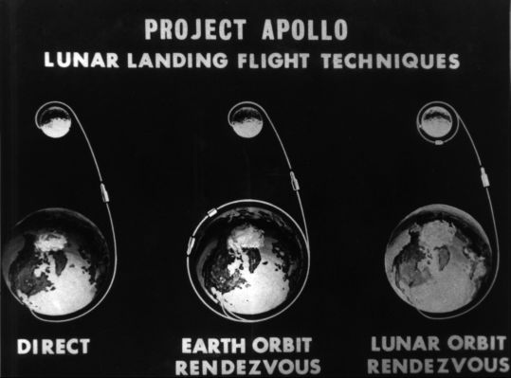
Architecture Drives What Hardware Is In Your System
EOR
LOR
Notes:
When the United States decided to go to the moon in 1962 there was a big argument about the system architecture. Most people, including Von Braun, favored a direct approach as the simplest system. A single large rocket would be assembled on the earth and launched directly to the moon. The rocket would be built in stages with early stages discarded after launch and later stages discarded on the moons surface. The benefit of this architecture is everything is assembled and checked out in configuration on the ground and the system stays together during the entire flight. This approach requires a HUGE rocket.
Earth Orbit Rendezvous (EOR) involved launching pieces on several large launchers and then assembling them in earth orbit for the flight to the moon. The disadvantage of this approach is that it required multiple launches and components couldn’t be fully checked out on the ground.
Lunar Obit Rendezvous (LOR) was viewed as the riskiest approach. Proposed by John Houbolt of NASA’s Langley Research Center it allows a much smaller landing vehicle and a smaller initial launcher but requires breaking the vehicles apart in lunar orbit and then rejoining them after the lunar surface part of the mission.

Slide 8
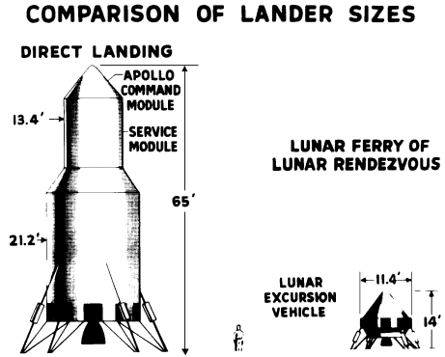
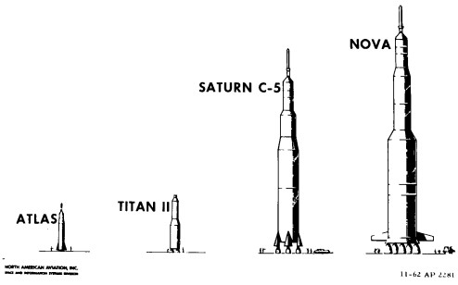
Architecture drives the configuration of the spacecraft and launch vehicle
NOVA needed for direct mission
Two Saturn C-5 for EOR
1 Saturn C-5 for LOR – option selected
Lunar Orbit Rendezvous was selected for Apollo because the required launch vehicles for other options could not have been ready in time for the end of the decade
Notes:
As can be seen, the lander required for a direct option (because you have to land the entire return vehicle) is HUGE and that results in a HUGE launch vehicle.
Houbolt did the math and realized that for every pound you land on the lunar surface, you need to carry 12 pounds of propellant into orbit. This is called the wheel ratio. So he realized that the architecture must minimize the size of the lander. This resulted in a launch vehicle that was significantly smaller.
Von Braun eventually came around to the logic of Houbolt’s argument. He realized that the time deadline of a decade to the moon would not have allowed the development of the much larger NOVA rocket and that the Saturn V was all that could be developed and tested in time.
If this architecture had not been selected, it is doubtful that America would’ve reached the moon.

Slide 9
Some wisdom
There is almost always more than one way to solve a problem
When you choose an architecture, you are really choosing the problems you prefer to work
  In the Apollo example, NASA choose to solve the lunar rendezvous problem rather than deal with huge launch vehicles
All solutions have problems. When you choose an architecture you want to choose one where the problems in the architecture are aligned with your strengths and capabilities.

Slide 10
DOD Architecture Framework
The Department of Defense Architecture Framework (DoDAF) defines a standard way to organize an enterprise architecture (EA) or systems architecture into complementary and consistent views.
All major DoD weapons and information technology system procurements are required to develop and document an EA using the views prescribed in the DoDAF.
While it is clearly aimed at military systems, DoDAF has broad applicability across the private, public and voluntary sectors around the world, and represents only one of a large number of systems architecture frameworks
It is especially suited to large systems with complex integration and interoperability challenges, and is apparently unique in its use of "operational views" detailing the external customer's operating domain in which the developing system will operate
Courtesy of Wikipedia

Slide 11
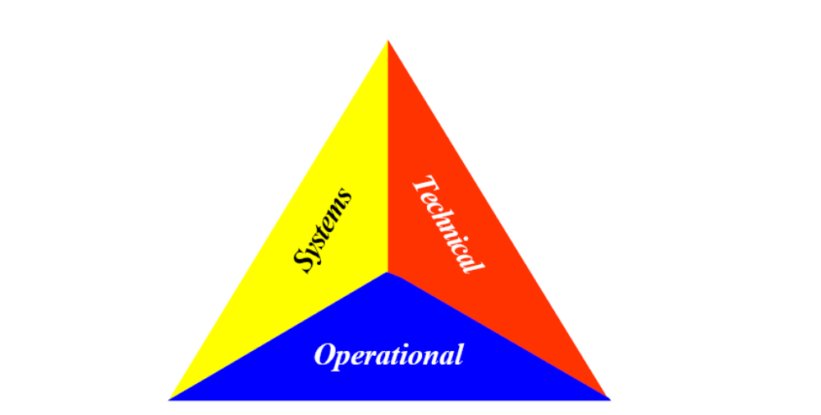
Four Views in the DODAF
All View – provides overarching descriptions of the entire architecture and defines the scope and context of the architecture
Operational View – provides descriptions of the tasks and activities, operational elements and information exchanges required to accomplish DOD missions
Systems View – provides graphical and textual descriptions of systems and systems interconnections that provide or support DOD functions
Technical Standards View – define technical standards, implementation conventions, business rules and criteria that govern the architecture
Each of these views is documented in a set of products
Courtesy Wikipedia

Slide 12
Logo For DODAF shows the three components

Slide 13
All View Products
AV-1 Overview and Summary Information - Scope, purpose, intended users, environment depicted, analytical findings (if applicable)
AV-2 Integrated Dictionary - Definitions of all terms used in all products.
Notes:
Self-explanatory

Slide 14
Operational View products
OV-1 High Level Operational Concept Graphic - High level graphical and textual description of operational concept (high level organizations, missions, geographic configuration, connectivity, etc).
OV-2 Operational Node Connectivity Description - Operational nodes, activities performed at each node, and connectivites and information flow between nodes.
OV-3 Operational Information Exchange Matrix - Information exchanged between nodes and the relevant attributes of that exchange such as media, quality, quantity, and the level of interoperability required.
OV-4 Organizational Relationships Chart - Command, control, coordination, and other relationships among organizations.
OV-5 Operational Activity Model - Activities, relationships among activities, inputs and outputs. In addition, overlays can show cost, performing nodes, or other pertinent information.
OV-6a Operational Rules Model - One of the three products used to describe operational activity sequence and timing that identifies the business rules that constrain the operation.
OV-6b Operational State Transition Description - One of the three products used to describe operational activity sequence and timing that identifies responses of a business process to events.
OV-6c Operational Event-Trace Description - One of the three products used to describe operational activity sequence and timing that traces the actions in a scenario or critical sequence of events.
OV-7 Logical Data Model - Documentation of the data requirements and structural business process rules of the Operational View.
Notes:
All of the OV products focus on the operational nodes of the architecture. An operational node is where things are happening! .It often includes some element of command and control that gives or received orders. It may relay orders or execute the orders.
OV-1 – the graphic is a cartoon that shows how the pieces tie together. The next page is an example of an OV-1 graphic regarding targeting weapons in a battle.
OV-2 explains what nodes in the architecture are doing things, who the nodes need to talk to and what information generically they need to exchange
OV-3 puts more detail into the information exchanged between the nodes including formatting and media and whether the formats are private between the nodes or system wide.
OV-4 shows who works for who – relationships for command and control
OV-5 shows the flow of activities – what activity feeds other activities ? What dependencies exist on other activities ? What are the inputs and outputs.
OV-6 shows how the system transitions between operating states (6a) (red, yellow, green in a traffic light are operating states ) or how an event triggers other events (6b)
OV-7 describes the data model – what data elements exist.

Slide 15
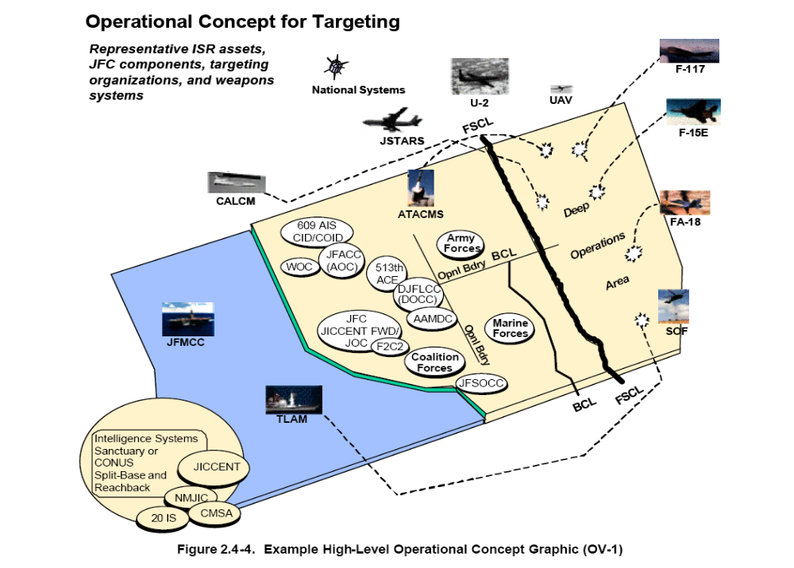
From DODAF Deskbook
Notes:
This is an example of an OV-1 graphic that shows how all of the different resources on the battlefield work together to identify a target, to assign weapons to the target and to fire weapons at the target. The different command and control centers that have to talk together are identified, Their relationship to certain boundaries is identified.
The pictures show weapons (SOF – special operations forces, FA-18, F-16, F117, TLAM and CALCM), reconnaissance systems that acquire information (U-2, JSTARS, UAVs) and control centers.
The FSCL is the Fire Support Coordination Line – basically the line separating our forces and the enemy forces.

Slide 16
Systems View Products
SV-1 System Interface Description - Identification of systems and system components and their interfaces, within and between nodes.
SV-2 Systems Communications Description - Physical nodes and their related communications lay downs.
SV-3 Systems-Systems Matrix - Relationships among systems in a given architecture. It can be designed to show relationships of interest, e.g., system-type interfaces, planned existing interfaces, etc.
SV-4 Systems Functionality Description - Functions performed by systems and the information flow among system functions.
SV-5 Operational Activity to Systems Functionality Traceability Matrix - Mapping of system functions back to operational activities.
SV-6 Systems Data Exchange Matrix - Detailing of data exchanges among system elements and applications allocated to system elements.
SV-7 Systems Performance Parameters Matrix - Performance Characteristics of each system's hardware and software elements, for the appropriate timeframes
Notes:
The key thing about these documents is that they are all oriented about systems versus the operational nodes.
SV-1 is similar to OV-2 except that it shows what systems are in each node and how these systems interface within and between nodes. There may be multiple systems within an operational node.
SVB-2 gets into the details of how communications (usually electronic) happen between the nodes. Is it wireless, or a Local Area Network, Voice, Video or Data ?
SV-3 – Shows the relationships between the systems. This may or may not reflect how the nodes talk together. A single system can be spread across multiple nodes or multiple independent systems can be located at a single node. SV-3 describes how the systems interact and interface.
SV-4 describes each of the systems, the functions they perform and what information needs to flow between them
SV-5 maps systems to operational activities – or in other words what systems fo you need to perform a given operational activity?
SV-6 is more about the details of the information exchanged between systems
SV-7 is a hardware and software description of each system

Slide 17
Systems View Products Continued
SV-8 Systems Evolution Description - Planned incremental steps toward migrating a suite of systems to a more efficient suite, or toward evolving a current system to a future implementation.
SV-9 Systems Technology Forecast - Emerging technologies and software and hardware products that are expected to be available in a given set of timeframes, and that will affect future development of the architecture.
SV-10a Systems Rules Model - One of three products used to describe systems activity sequence and timing -- Constraints that are imposed on systems functionality due to some aspect of systems design or implementation.
SV-10b Systems State Transition Description - One of three products used to describe systems activity sequence and timing -- Responses of a system to events.
SV-10c Systems Event-Trace Description - One of three products used to describe systems activity sequence and timing -- System specific refinements of critical sequences of events described in the operational view.
SV-11 Physical Schema - Physical implementation of the information of the Logical Data Model, e.g., message formats, file structures, and physical schema
Notes:
SV-8 describes what the plan is to evolve or grow the system as experience is gained and requirements change,
SV-9 is a technology forecast that identified what technology can be available and at what timeframes to be used in the architecture.
SV-10a thru 10C – covers the state transitions of the systems and how events trigger the systems
SV-11 shows how the data elements are structured in a database. For example in a phonebook, each entry may have a name, a phone number and an address

Slide 18
Technical Standards View Products
TV-1 Technical Standards Profile - Extraction of standards that applies to the given architecture.
TV-2 Technical Standards Forecast - Description of emerging standards that are expected to apply to the given architecture, within an appropriate set of timeframes.
Notes:
Slelf explanatory

Slide 19
Minimum Products to Define an Architecture
DoDAF v1.0 listed the following products as the “minimum set of products required to satisfy the definition of an OV, SV and TV.” One note: while the DoDAF does not list the OV-1 artifact as a core product, its development is strongly encouraged. The sequence of the artifacts listed below gives a suggested order in which the artifacts could be developed. The actual sequence of view generation and their potential customization is a function of the application domain and the specific needs of the effort.
  AV-1 Overview and Summary Information
  AV-2 Integrated Dictionary
  OV-1 High Level Operational Concept Graphic
  OV-5 Operational Activity Model
  OV-2 Operational Node Connectivity Description
  OV-3 Operational Information Exchange Matrix
  SV-1 System Interface Description
  TV-1 Technical Standards Profile
Notes:
All of the products are a bit daunting and probably can’t be completed until the system is well into its development.
If the only way you can describe an architecture is by a picture of the finished building, then the architecture description doesn’t help you very much.
Accordingly DOD specified a minimum set which satisfies an architectural description for the purposes of development.
This is a reasonable set of things that you should have before you start a system development.
This architecture tends to be oriented more towards electronic systems rather than fluid-mechanical systems, but many of the principle still apply.

Slide 20
Examples
Examples of these types of products are contained in the DODAF deskbook
https://acc.dau.mil/CommunityBrowser.aspx?id=31667

Slide 21
Architecture Description Documents
Architecture Description Documents (ADD) provide a clear explanation of the
  The system components
  Their relationship to each other
  Their interfaces
  The relationship to the external environment
  The interfaces to the external environment
Details of interfaces are usually in an Interface Control Document (ICD)
The most important part of an ADD is the system diagram

Slide 22
Power of a drawing
The most powerful way to communicate architecture is through pictures
It is easy to be in a meeting and be discussing a topic for an extended time and the different people may have a different idea of how the components are arranged with respect to each other
When this happening, the most important thing to do is grab a pen and start drawing
  Feel free to use humor
The drawing is a very powerful tool

Slide 23
What is a trade study ?
A trade study is just an analysis of alternatives
The topic being traded may be an architecture or selection of components
The key to a good trade is the analysis behind the selection
Avoid pseudo-quantitative methods where possible. Apply quantitative where you can but avoid putting numbers to things just to generate numbers

Slide 24
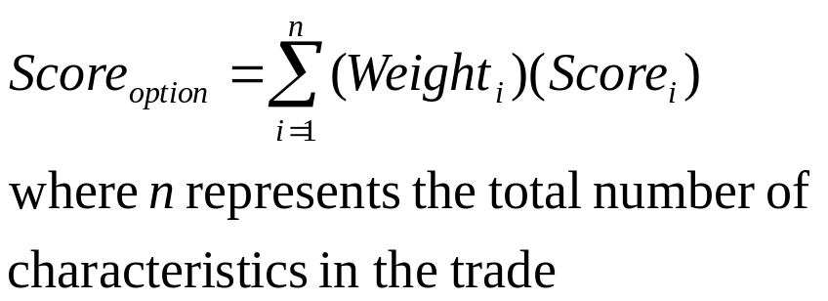
“Semi-Numerical Type” Technique
This consists of a way of quantitatively describing a trade
Basically you identify
  The characteristics associated with the trade
  The relative importance of each of the characteristics
  For each of the trade options, evaluate the option and give it a rating for each characteristic
  Then form a total score

Slide 25
“Semi-Numerical” example
Movie Title/Value Factor | Action Rating (5) | Effects Rating (5) | Plot Rating (2) | Character Rating (1) | Duration rating (1) | Total
Gone With The Wind
Star Wars
The Sound of Music
ET
Titanic
Jaws

Slide 26
“Semi-Numerical Type” analysis is usually not objective !
Even though it uses numbers, “Semi-Numerical Type” more often just reflects a way of organizing opinions about importance of characteristics and opinions about how well options meet a characteristics rather than true objective data
  Exception would be where the characteristics in the trade can be truly quantitatively measured by an objective standard
    Even then, the weighting importance is usually a judgment call
Feel free to use the technique, but be careful in how you use it

Slide 27
Operational Scenarios as a way to test architectures
One of the best way to test architectures is to exercise them in different operational scenarios
  Take a diagram of a system, put it up on a wall
  Postulate a reasonable operational scenario
  Walk through the system response in time by placing markers (post-its, push pins) to indicate the status of each element of the system
  Evaluate the architectures response

Slide 28
Any Questions ?

